Slide 1
APUSH Review: Key Documents To Know From Period 5
Everything You Need To Know About Period 5 Documents To Succeed In APUSH

Slide 2
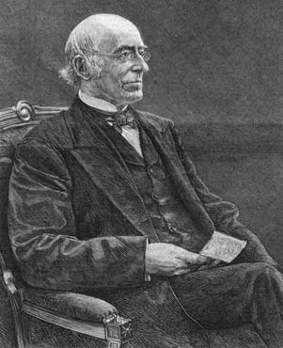
William Lloyd Garrison
Who was he?
Publisher of The Liberator, an abolitionist newspaper
“I am aware, that many object to the severity of my language; but is there not cause for severity? I will be as harsh as truth, and as un-compromising as justice. On this subject, I do not wish to think, or speak, or write, with moderation. No! no! Tell a man whose house is on fire, to give a moderate alarm;….. – but urge me not to use moderation in a cause like the present. I am in earnest - I will not equivocate - I will not excuse - I will not retreat a single inch - and I will be heard.”
Possible multiple-choice and short answer tips:
Example of abolitionism in North, although a minority
Used fierce arguments against the institution of slavery

Slide 3
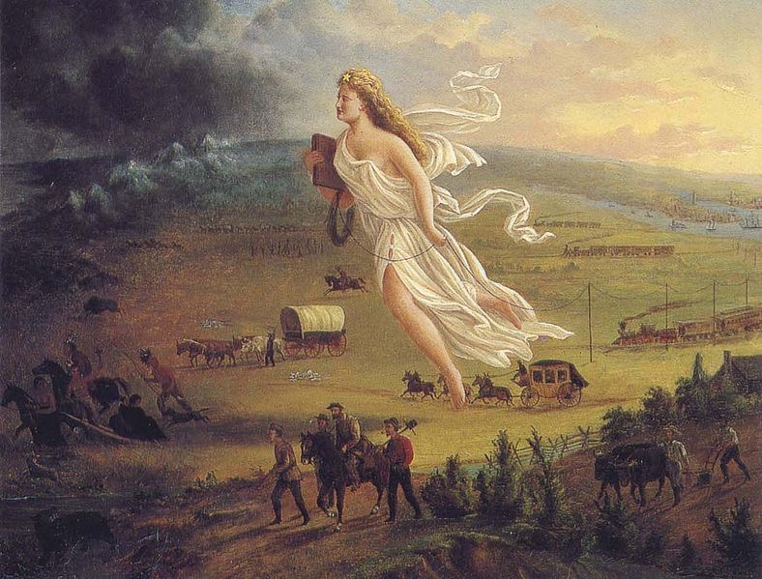
Manifest Destiny
What do we notice?
Columbia is moving westward with telegraph lines
Many Americans are moving westward - towards darkness
Native Americans are moving further west
Implications of the cartoon?
Manifest Destiny is seen as positive
Possible multiple-choice and short answer tips:
Environmental transformation
near-extinction of the buffalo
Impact on groups of people
Native Americans, families, etc.
Ways the government encouraged expansion
Homestead Act (1862), RR subsidies
John Gast, American Progress,
1872

Slide 4
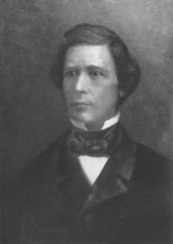
Wilmot Proviso
What was it?
An amendment to a bill that proposed banning slavery in the Mexican Cession land
What did it say?
“Provided, That, as an express and fundamental condition to the acquisition of any territory from the Republic of Mexico by the United States, by virtue of any treaty which may be negotiated between them, and to the use by the Executive of the moneys herein appropriated, neither slavery nor involuntary servitude shall ever exist in any part of said territory, except for crime, whereof the party shall first be duly convicted.”
Possible multiple-choice and short answer tips:
Impact of the Mexican American War
Example of heated controversy over slavery in newly acquired territories

Slide 5
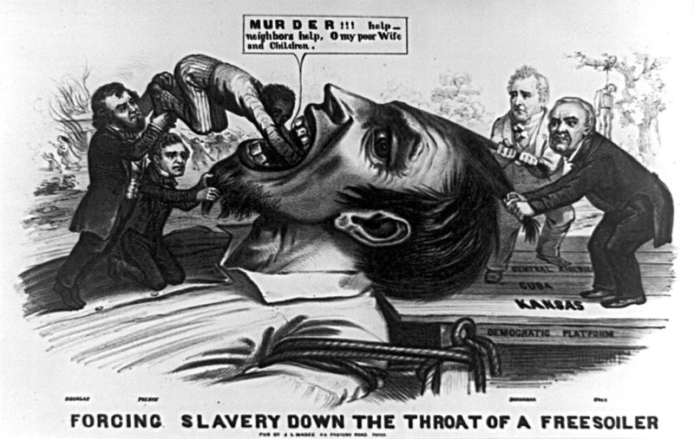
Kansas-Nebraska Act
Louis Cass
James Buchanan
What do we notice?
4 Democrats
Slave being forced down a free-soiler’s throat
Implications of cartoon?
KS-NB Act is seen as negative
Democratic Party is the culprit
Possible multiple- choice and short answer tips:
KS-NB was a proposal to settle issue of slavery in territories
Overturned the MO Compromise
Instituted popular sovereignty in KS and NB
Violence soon emerged in “Bleeding Kansas”
Franklin Pierce
Steven Douglas

Slide 6
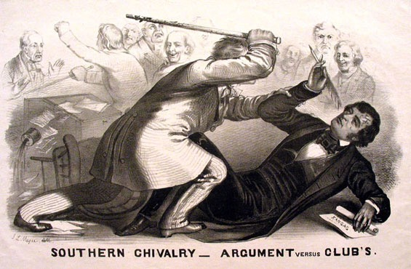
The Caning of Charles Sumner
Why did this happen?
Charles Sumner criticized slavery and its supporters (Andrew Butler)
Butler’s nephew, Congressman Preston Brooks took exception to Sumner’s speech
Possible multiple-choice and short answer tips:
Example of breaking down of trust between leaders
Demonstrates tensions between North and South
Helped inspire violent abolitionism (John Brown)
Southern Chivalry – Argument versus Club’s, 1856

Slide 7
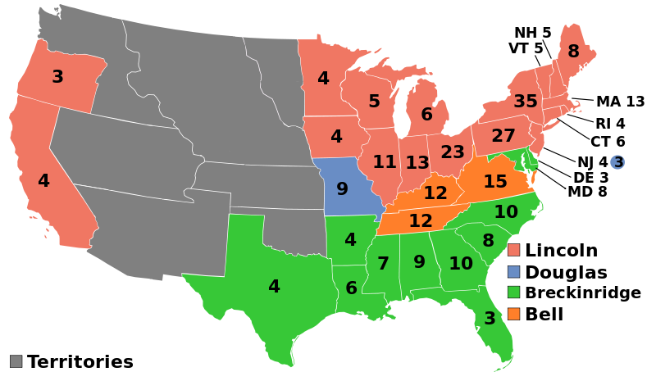
The Election of 1860
What do we notice?
Lincoln won, without carrying a single southern state
Democratic Party was split along sectional lines: North - Douglas, South - Breckinridge
Multiple-Choice and Short Answer tips:
Lincoln’s campaigned on a Free-soil platform - Nonextension of slavery
Impact of Election?
Southern states began to secede from the Union
Electoral map of the
Election of 1860

Slide 8
Lincoln’s Letter to Horace Greeley, April 22, 1862
Message of the excerpt?
Lincoln, in the beginning, sought to preserve the union at all costs
Multiple-choice and short answer tips:
How Lincoln’s war goals changed as time elapsed
Emancipation Proclamation, Gettysburg Address
“I would save the Union. I would save it the shortest way under the Constitution. The sooner the national authority can be restored; the nearer the Union will be "the Union as it was." If there be those who would not save the Union, unless they could at the same time save slavery, I do not agree with them. If there be those who would not save the Union unless they could at the same time destroy slavery, I do not agree with them. My paramount object in this struggle is to save the Union, and is not either to save or to destroy slavery.”

Slide 9
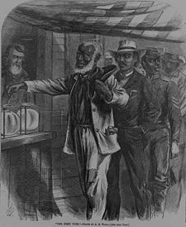
Reconstruction: 15th Amendment
What do we notice?
African American males are lining up to vote
Military official - impact of Emancipation Proclamation
Implications of the cartoon?
Black suffrage is seen as positive
Multiple-choice and short answer question tips:
Southern resistance to 15th amendment
Impacts of the amendment on the Women’s Rights groups
The First Vote, 1867

Slide 10
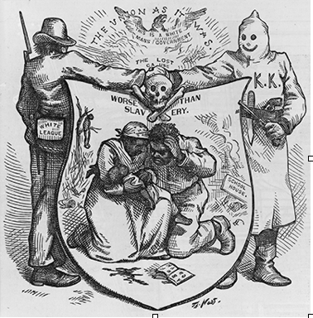
Reconstruction: Resistance to Civil Rights
What do we notice?
KKK and White League are joining hands
“Worse than slavery”
Implications of cartoon?
KKK, White League, and other organizations terrorized African Americans
Would use violence to meet their goals
Multiple-choice and short answer tips:
Organizations were formed to resist the 13 - 15 amendments
Southern resistance to Radical Republicans and Reconstruction was strong

Slide 11
Now It’s Your Turn…
On the first day of January, in the year of our Lord one thousand eight hundred and sixty-three, all persons held as slaves within any State in rebellion against the United States, shall be forever free. . .
Now, therefore I, Abraham Lincoln, President of the United States, by virtue of the power in me vested as Commander- in-Chief, of the Army and Navy of the United States. . .do order and designate [appoint] the following States as being in rebellion:
Arkansas, Texas, Louisiana, Mississippi, Alabama, Florida, Georgia, South Carolina, North Carolina, and Virginia.
And I hereby call upon the people so declared to be free to abstain from all violence, unless in necessary self-defense; and I recommend to them that, in all cases when allowed, they labor faithfully for reasonable wages.
And I further declare and make known, that such persons will be received into the armed service of the United States.
And upon this act, sincerely believed to be an act of justice, warranted by the Constitution, upon military necessity, I invoke the considerate judgment of mankind, and the gracious favor of Almighty God.
By the President: ABRAHAM LINCOLN
What is the message of this document? What could be multiple-choice and short answer test tips for this document?

Slide 12
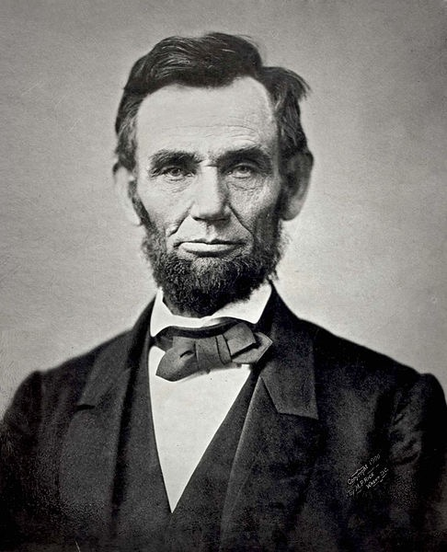
Good Luck!
Thanks for watching
Please subscribe, share with others
Check out all my videos related to the new curriculum
Best of luck on all your tests!

